Slide 1
3D Video Overview
John Reister
May 2011

Slide 2














BigBand Networks
Digital Video Networking experts
  Silicon Valley HQ, R&D in North America, Israel, & China
  TL9000 certified vendor
Recognized Video Innovator
  80+ patents granted or in process
  Pioneered Switched Digital Video (Emmy)
  Leader in Edge QAM
  TimeShift TV (Emmy)
Successful leader
  More than 1 Billion Ad Splices/Year
  50+ Million Subscribers Worldwide
  200+ Service Provider Customers
    9 out of 10 Largest Cable Operators
    50 Operators in China

Slide 3

3D: Of Chickens and Eggs
Content Provider must spend more to create 3D content
Operator must allocate bandwidth to carry content
Operator has to create and support service
Consumer pays for 3D services
Consumer must buy TV Set
Catalyst:
Gaming
3D Movies on BluRay
*Picture from Toshiba

Slide 4


















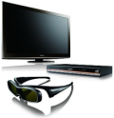

















3D TV – Killer App or Passing Fad?
Studios and Programmers
TV, DVD and Gamers
Cable, Satellite and Telco
  Stakeholders Motivated for Differentiation and New Rev Streams
Notes:
4
3D Market
Key Players, Consumer Electronic Manufacturers, Studios, MSO’s; All are motivated to make this happen in 2010 and beyond
Consumer Electronics – Differentiator to encourage investment beyond HD
Studios – Drive new revenue streams on TV
MSO – Continued differentiation with consumers
Market Stats “Insight Media – 2010 3D TV Report”
Studio Perspective
Announced 3D Movies 2010 (56), Planned Blu-Ray 3D Releases 2010 (12-25)
Programming Perspective
Samsung + Technicolor + DreamWorks – Starts in April
Produce 3D Blu-ray discs, Monsters vs. Aliens and Toy Story exclusives
Technicolor setting up cable 3D channel in UK
ESPN - Starts in June 2010
85 events planned in first year (starting with 2010 FIFA World Cup in June)
24/7 3D sports broadcasting
Negotiating with production & distribution partners now
DirecTV + Panasonic - Starts June 2010
Pay per view channel, occasional 3D channel and video on demand channel
Movies, sports and entertainment
Discovery + IMAX + Sony - Launch in 2011
Entertainment, sports and nature content
3D distribution Perspective
Live Events 2010 – 35 Pay Per View
Video On Demand Channels 2010 – approx. 15
Internet Channels 2010 – approx 12-15
Cable and Satellite Channels 2010 – approx 8-12
Terrestrial Broadcast Channels 2010 – approx 1-2
User Generated Video 2010 – 8000 on YouTube Now
TV Maker Perspective
Every Major TV Maker will offer (1-14) 3D TV models in 2010

Slide 5
Market Projections
Analysts expect 100% of all sets 40-inch and larger to be 3D-enabled.
Households with 3D TV sets will eclipse 300 million by 2015
In 2011, Europe alone will see a 7 million increase in 3D sets
Very high growth rate
Source: In-stat, May 2011

Slide 6
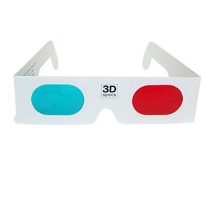
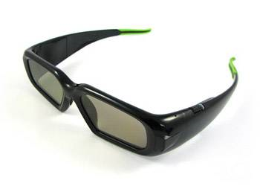
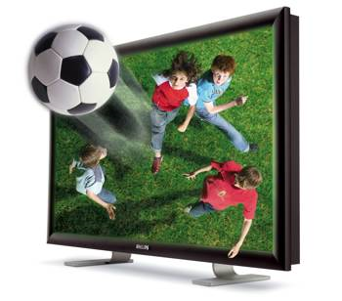
3D Video Basic Overview
Anaglyph
  A stereoscopic picture consisting of two images of the same object, taken from slightly different angles, in two complementary colors, usually red and cyan (green-blue, and other color combinations possible)
Stereoscopic
  Three-dimensional for giving the illusion of depth from two-dimensional images or reproductions, as of a photograph or motion picture
  Circular Polarized Glasses/Active Shutter Glasses
Auto-stereoscopic
  Method of displaying three-dimensional images that can be viewed without the use of special headgear or glasses
  Will be used for digital signage
Notes:
6

Slide 7
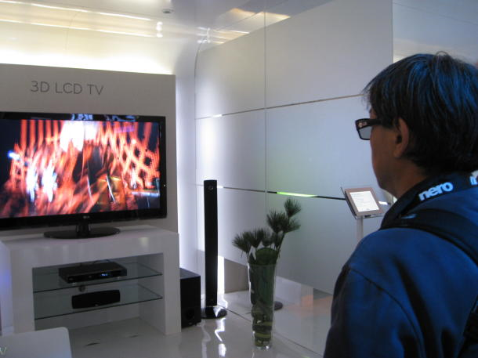
3D Video MSO Delivery Requirement
For 3D transmission, Cable/Satellite operators
  Want to use existing set top boxes
  Want to use existing 2D infrastructure and compression methods
  Want to use existing in-home cabling
  Want to have new 3DTVs create required 3D signal
Notes:
7

Slide 8
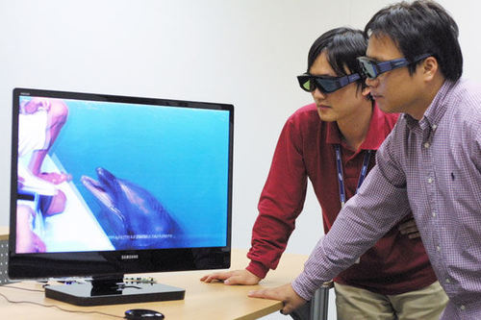
3D Video MSO Delivery Options
The solution: frame compatible 3D signal packaging
  Possible with firmware update
  There will be some implementation issues
  Higher bandwidth solutions may come later
Frame Compatible Types
  Row Discrimination and Top to Bottom
  Colum Discrimination and Side by Side
  Checker Board and Side By Side
Notes:
8

Slide 9



Row Discrimination and Top to Bottom
Left Eye
Filtering
Packaging
Top/Bottom
L | L | L | L | L | L | L | L | L | L | L | L | L | L | L | L
L | L | L | L | L | L | L | L | L | L | L | L | L | L | L | L
L | L | L | L | L | L | L | L | L | L | L | L | L | L | L | L
L | L | L | L | L | L | L | L | L | L | L | L | L | L | L | L
L | L | L | L | L | L | L | L | L | L | L | L | L | L | L | L
L | L | L | L | L | L | L | L | L | L | L | L | L | L | L | L
L | L | L | L | L | L | L | L | L | L | L | L | L | L | L | L
L | L | L | L | L | L | L | L | L | L | L | L | L | L | L | L
L | L | L | L | L | L | L | L | L | L | L | L | L | L | L | L
L | L | L | L | L | L | L | L | L | L | L | L | L | L | L | L
R | R | R | R | R | R | R | R | R | R | R | R | R | R | R | R
R | R | R | R | R | R | R | R | R | R | R | R | R | R | R | R
R | R | R | R | R | R | R | R | R | R | R | R | R | R | R | R
R | R | R | R | R | R | R | R | R | R | R | R | R | R | R | R
Right Eye
R | R | R | R | R | R | R | R | R | R | R | R | R | R | R | R
R | R | R | R | R | R | R | R | R | R | R | R | R | R | R | R
R | R | R | R | R | R | R | R | R | R | R | R | R | R | R | R
R | R | R | R | R | R | R | R | R | R | R | R | R | R | R | R
Loss of vertical resolution
Preferred for 720 or 1080p content
Notes:
9

Slide 10

Column Discrimination and Side By Side
Left Eye
Filtering
Packaging
Side/Side
L |  | L |  | L |  | L |  | L |  | L |  | L |  | L
L |  | L |  | L |  | L |  | L |  | L |  | L |  | L
L |  | L |  | L |  | L |  | L |  | L |  | L |  | L
L |  | L |  | L |  | L |  | L |  | L |  | L |  | L
L |  | L |  | L |  | L |  | L |  | L |  | L |  | L
L |  | L |  | L |  | L |  | L |  | L |  | L |  | L
L |  | L |  | L |  | L |  | L |  | L |  | L |  | L
L |  | L |  | L |  | L |  | L |  | L |  | L |  | L
L |  | L |  | L |  | L |  | L |  | L |  | L |  | L
L | L | L | L | L | L | L | L | R | R | R | R | R | R | R | R
L | L | L | L | L | L | L | L | R | R | R | R | R | R | R | R
L | L | L | L | L | L | L | L | R | R | R | R | R | R | R | R
L | L | L | L | L | L | L | L | R | R | R | R | R | R | R | R
L | L | L | L | L | L | L | L | R | R | R | R | R | R | R | R
L | L | L | L | L | L | L | L | R | R | R | R | R | R | R | R
L | L | L | L | L | L | L | L | R | R | R | R | R | R | R | R
L | L | L | L | L | L | L | L | R | R | R | R | R | R | R | R
L | L | L | L | L | L | L | L | R | R | R | R | R | R | R | R
Right Eye
 | R |  | R |  | R |  | R |  | R |  | R |  | R |  | R
 | R |  | R |  | R |  | R |  | R |  | R |  | R |  | R
 | R |  | R |  | R |  | R |  | R |  | R |  | R |  | R
 | R |  | R |  | R |  | R |  | R |  | R |  | R |  | R
 | R |  | R |  | R |  | R |  | R |  | R |  | R |  | R
 | R |  | R |  | R |  | R |  | R |  | R |  | R |  | R
 | R |  | R |  | R |  | R |  | R |  | R |  | R |  | R
 | R |  | R |  | R |  | R |  | R |  | R |  | R |  | R
 | R |  | R |  | R |  | R |  | R |  | R |  | R |  | R
Loss of horizontal resolution
Preferred for 1080i content
Notes:
10

Slide 11



Checker Board and Side By Side
Left Eye
Filtering
Packaging
Side/Side
L |  | L |  | L |  | L |  | L |  | L |  | L |  | L
 | L |  | L |  | L |  | L |  | L |  | L |  | L |  | L
L |  | L |  | L |  | L |  | L |  | L |  | L |  | L
 | L |  | L |  | L |  | L |  | L |  | L |  | L |  | L
L |  | L |  | L |  | L |  | L |  | L |  | L |  | L
 | L |  | L |  | L |  | L |  | L |  | L |  | L |  | L
L |  | L |  | L |  | L |  | L |  | L |  | L |  | L
 | L |  | L |  | L |  | L |  | L |  | L |  | L |  | L
L |  | L |  | L |  | L |  | L |  | L |  | L |  | L
L | L | L | L | L | L | L | L | R | R | R | R | R | R | R | R
L | L | L | L | L | L | L | L | R | R | R | R | R | R | R | R
L | L | L | L | L | L | L | L | R | R | R | R | R | R | R | R
L | L | L | L | L | L | L | L | R | R | R | R | R | R | R | R
L | L | L | L | L | L | L | L | R | R | R | R | R | R | R | R
L | L | L | L | L | L | L | L | R | R | R | R | R | R | R | R
L | L | L | L | L | L | L | L | R | R | R | R | R | R | R | R
L | L | L | L | L | L | L | L | R | R | R | R | R | R | R | R
L | L | L | L | L | L | L | L | R | R | R | R | R | R | R | R
Right Eye
 | R |  | R |  | R |  | R |  | R |  | R |  | R |  | R
R |  | R |  | R |  | R |  | R |  | R |  | R |  | R
 | R |  | R |  | R |  | R |  | R |  | R |  | R |  | R
R |  | R |  | R |  | R |  | R |  | R |  | R |  | R
 | R |  | R |  | R |  | R |  | R |  | R |  | R |  | R
R |  | R |  | R |  | R |  | R |  | R |  | R |  | R
 | R |  | R |  | R |  | R |  | R |  | R |  | R |  | R
R |  | R |  | R |  | R |  | R |  | R |  | R |  | R
 | R |  | R |  | R |  | R |  | R |  | R |  | R |  | R
Checkerboard and additional proprietary filtering techniques can be used too
Add enhancement special layer or metadata if decoder not present
These can then be packed as side-by-side or top/bottom
Notes:
11

Slide 12
3D Play Back Landscape
Blu-Ray Spec
  MPEG-4 MVC (Mutiview Video Coding)
  Players will decode to create two streams
    1080p/24 per eye for movies
    720p/60/50 per eye for games and other sources
HDMI Requirements
  1.4 provides auto signaling support
  1.3 with upgrade will support but static
PC and Gaming Consoles
  New hardware video cards and software updates
  Firmware upgrade for gaming consoles
Notes:
12

Slide 13
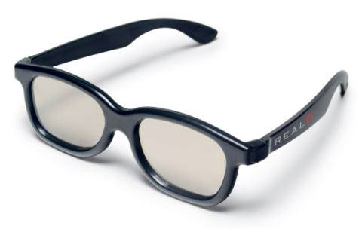
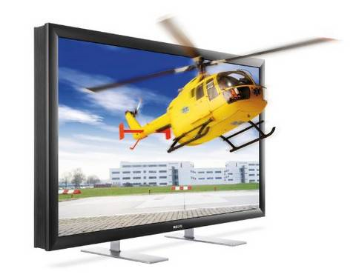
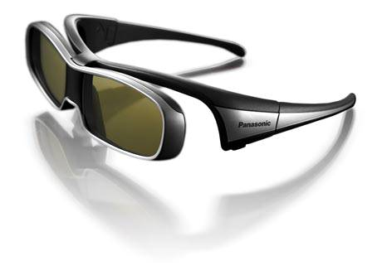
3D Glasses Landscape
Polarized
  Left and right lenses block out image
Shutter
  Sync signals tell the liquid crystal shutters in the glasses to pass or block light to each eye
IR, or Bluetooth Transmitter
The vast majority of 3D solutions will use active shutter glasses
Passive used in public and post production
Notes:
13

Slide 14
MSO Deployment Challenges
In addition to consumer-facing implications, there are also big network implications for 3D TV:
  Encoding, metadata, advertising breaks, ETV and graphics, compression, bandwidth
The number of video types (SD, HD, 3D TV formats) is proliferating along with the number of platforms and sheer volume of video being consumed
Service providers are counting on using their existing network to deliver 3D TV.
  This translates to a need for existing network equipment and bandwidth optimization to support 3D TV today and continued innovation that leverages existing infrastructure going forward.
  Delivery of 3D TV Will Be an Evolution not Revolution
Notes:
14

Slide 15
Need an Evolution, Not a Revolution
Relative Bandwidth for Delivering Content to Multiple Screens
Bandwidth
Capital cost efficiencies
Ability to monetize more personalized TV services
Platforms to deliver IPTV
Operational ease
Rapid deployment, scale,
and experience
Channel / Spectrum Map
Time
Source: Company Estimates
Notes:
15

Slide 16
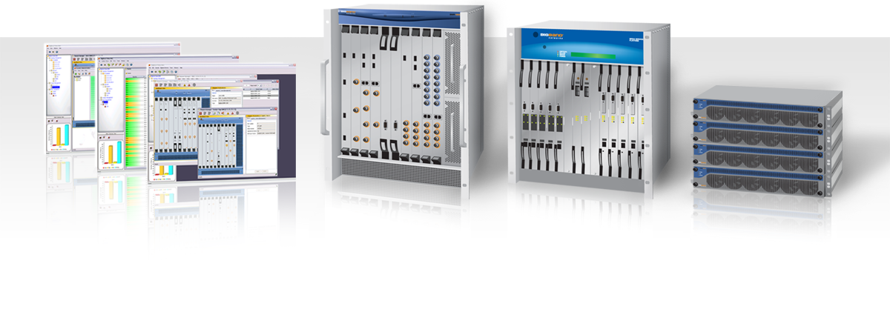
Video Acquisition, Processing and Transport
Broadcast, Unicast, Edge QAM, Digital Video Management
Video Processing of MPEG-2 and MPEG-4 SD and HD
Video Processing of MPEG-2 and MPEG-4 3D TV
Ad insertion
Slide 16

Slide 17






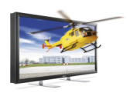




Cost-Effective Means to Find Bandwidth for 3D:
Switched Digital Video Bandwidth Optimization
With SDV, Broadcast no longer scales with available programming
SDV reclaims bandwidth and allows channel lineup expansion for HD and 3D Services
Switched
Digital
Broadcast
System
Plant
Bandwidth
Required

Slide 18








Sharing Bandwidth for Traditional Video, 3D, IP Video:
Video Delivery Control Plane Management
Treats network bandwidth in the service group as a common resource across all applications
SDV
VIP
ERM
Optimization
CVEx today = SDV + ERM + VIP Modules
Opportunity for future expansion….
External Session Mgr. Interfaces
Edge Resource Interfaces
CVEx Core
Operates as stand-alone server or in Blade Server
Device capabilities
Management Plane VMS, SVA, etc.
High Density QAM
Shared Bandwidth SuperGroup™

Slide 19
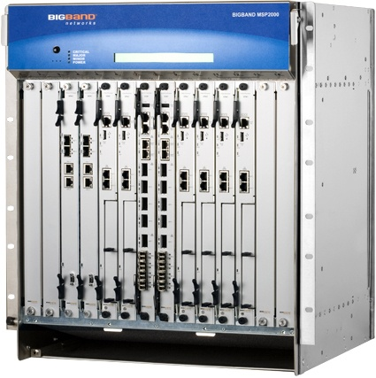
Generating Revenue with Advertising
Integrated solution with high bandwidth for moving the streams, and high availability so services are not disrupted
  12 Multi Application Slots, Dual Switch Cards
  Full Component and Chassis Redundancy
Flexible ad splicing
  Multi Zoned Splicing Applications
  MPEG-2, MPEG-4 SD, HD and 3D Splicing
  CBR, VBR, VBR Capped Input and Output
  Splicing Into Encrypted Streams
    Netcrypt, Widevine, Verimatrix, DigiCipher II, Microsoft
Integrated Ad Serving
  Lowers the cost and improves scalability
Notes:
19

Slide 20

Summary
Partnership
3D is around the corner
  Gaming and BluRay movies coupled with TV manufacturers will cause adoption at the high end
  Services will follow
Don’t get caught unable to offer service cost-effectively or unable to monetize
  Use Scalable and Highly Available Platforms
  Solve Bandwidth and Scale Challenges – leverage SDV to reclaim bandwidth
  Generate revenue through advertising
Find vendors who treat you like partners
Slide 20

Slide 21





Thank You!
Notes:
21

